Slide 1
Policy Instruments -3
Market power
Adverse selection
Enforcement

Slide 2
0 Introduction
1 Social choice
2 Externalities and public goods
3 Decision analysis
4 Valuation: Aims and purpose
5 Valuation: Revealed preferences
6 Valuation: Stated preferences
7 Direct regulation
8 Market-based instruments
9 Complications with instruments
10 Growth and the environment
11 Green accounting

Slide 3
Policy Instruments -3
Market power
Adverse selection
Enforcement

Slide 4
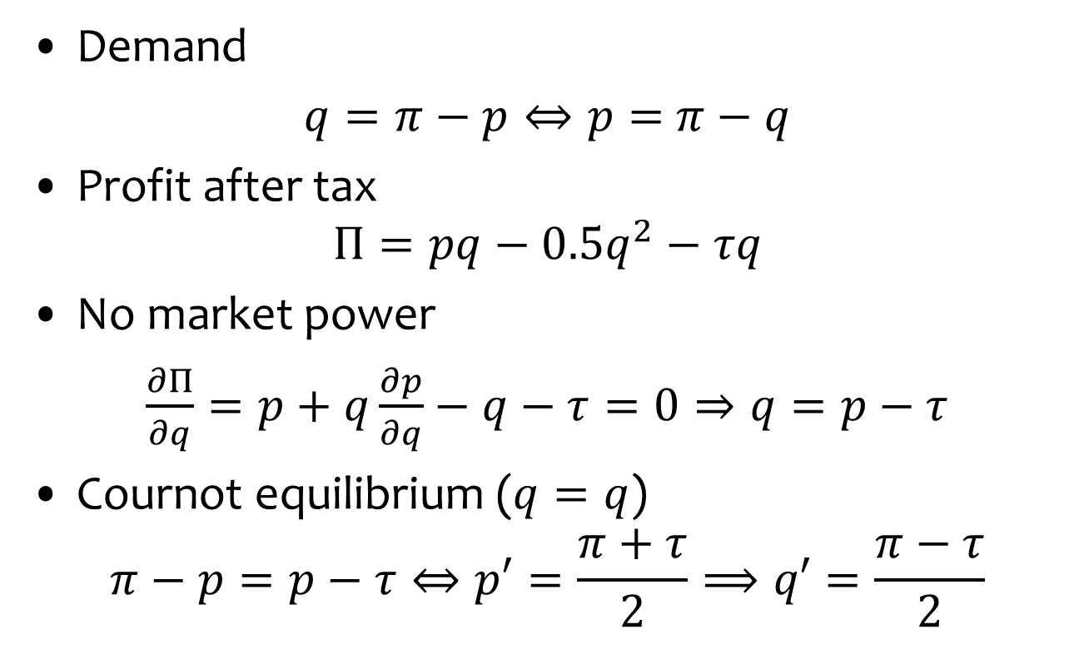
Price-taker
Demand
$q=π−p⇔p=$ $π−q$
Profit after tax
$$Π=pq−0.5q^{2}−τq$$
No market power
$\frac{∂Π}{∂q}=p+q\frac{∂p}{∂q}−q−τ=0⇒q=p−$ $τ$
Cournot equilibrium ($q=q$)
$$π−p=p−τ⇔p′=\frac{π+τ}{2}⟹q′=\frac{π−τ}{2}$$
0

Slide 5
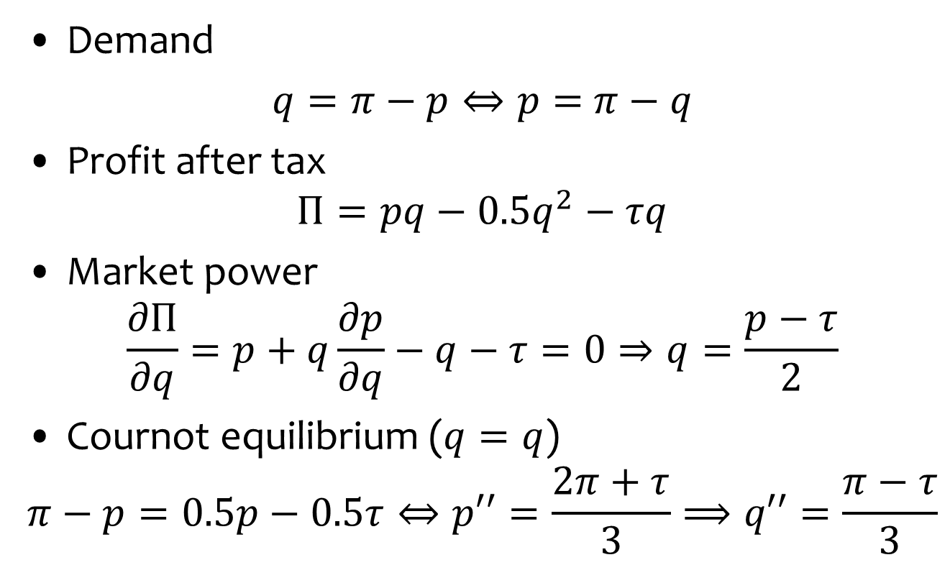
Monopolist
Demand
$q=π−p⇔p=$ $π−q$
Profit after tax
$$Π=pq−0.5q^{2}−τq$$
Market power
$$\frac{∂Π}{∂q}=p+q\frac{∂p}{∂q}−q−τ=0⇒q=\frac{p−τ}{2}$$
Cournot equilibrium ($q=q$)
$$π−p=0.5p−0.5τ⇔p′′=\frac{2π+τ}{3}⟹q′′=\frac{π−τ}{3}$$
-1

Slide 6

Comparison
Price-taker
$$q′=\frac{π−τ}{2}$$
Monopolist
$$q′′=\frac{π−τ}{3}$$

Slide 7
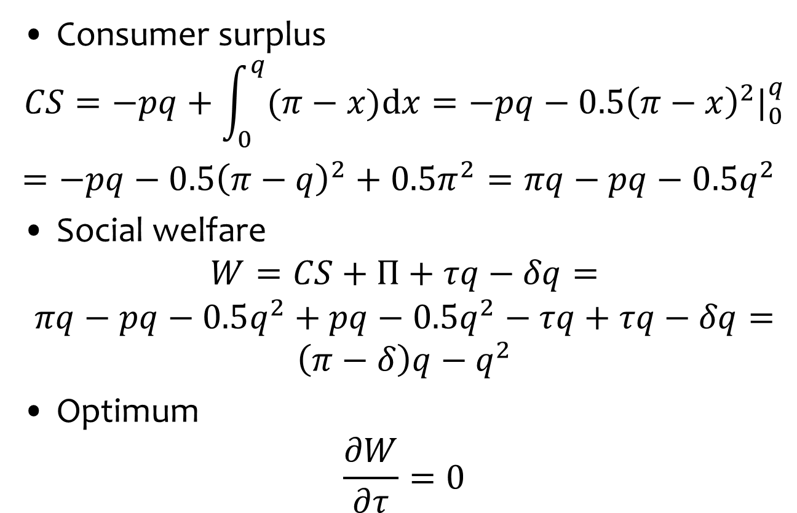
Social planner
Consumer surplus
$$CS=−pq+\int_{0}^{q}{(π−x)\text{d}x}=−pq−0.5{\left(π−x\right)}^{2}|_{0}^{q}$$
$=−pq−0.5{\left(π−q\right)}^{2}+0.5π^{2}=πq−pq−$ ${0.5q}^{2}$
Social welfare
$$W=CS+Π+τq−δq=$$
$$πq−pq−0.5q^{2}+pq−0.5q^{2}−τq+τq−δq=$$
$$\left(π−δ\right)q−q^{2}$$
Optimum
$$\frac{∂W}{∂τ}=0$$

Slide 8
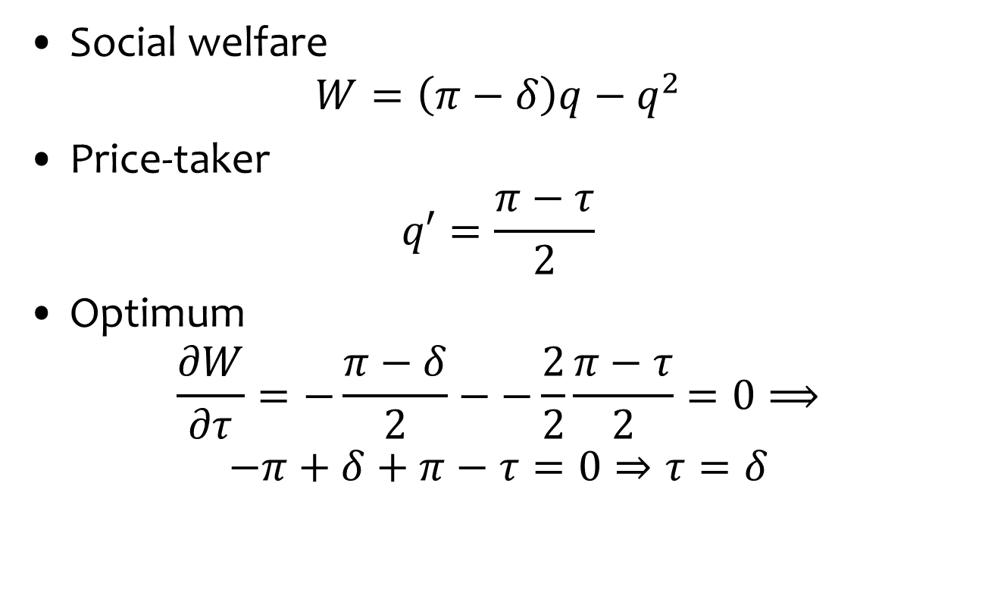
Social planner + price-taker
Social welfare
$$W=\left(π−δ\right)q−q^{2}$$
Price-taker
$$q′=\frac{π−τ}{2}$$
Optimum
$$\frac{∂W}{∂τ}=−\frac{π−δ}{2}−−\frac{2}{2}\frac{π−τ}{2}=0⟹$$
$$−π+δ+π−τ=0⇒τ=δ$$

Slide 9
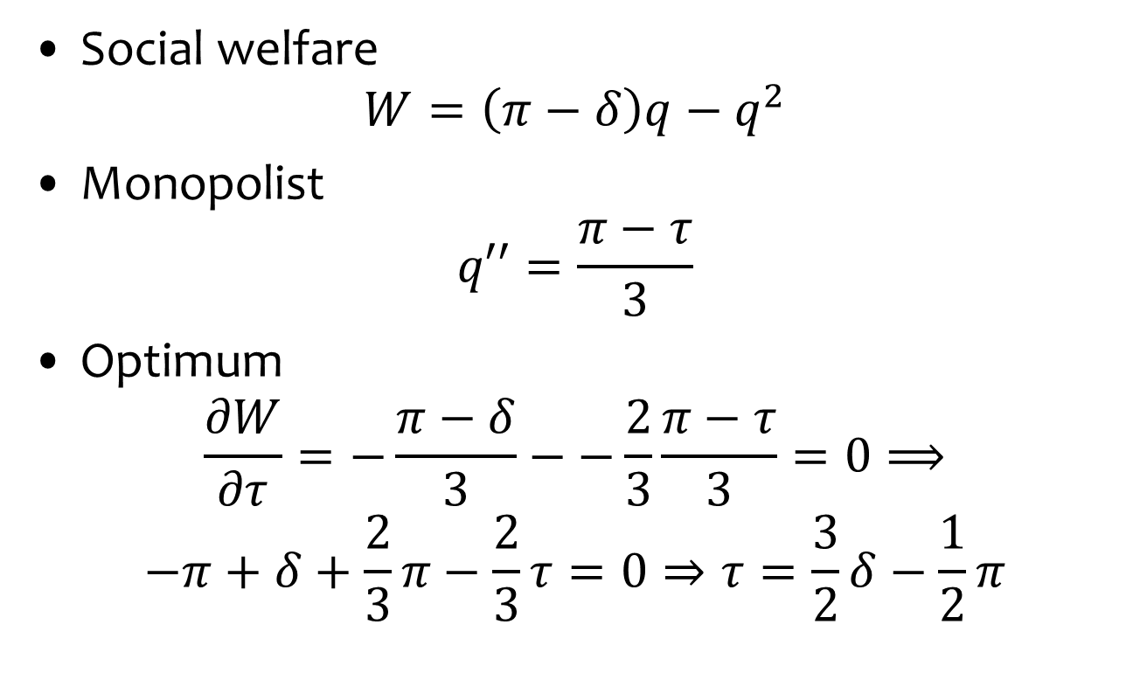
Social planner + monopolist
Social welfare
$$W=\left(π−δ\right)q−q^{2}$$
Monopolist
$$q′′=\frac{π−τ}{3}$$
Optimum
$$\frac{∂W}{∂τ}=−\frac{π−δ}{3}−−\frac{2}{3}\frac{π−τ}{3}=0⟹$$
$$−π+δ+\frac{2}{3}π−\frac{2}{3}τ=0⇒τ=\frac{3}{2}δ−\frac{1}{2}π$$

Slide 10
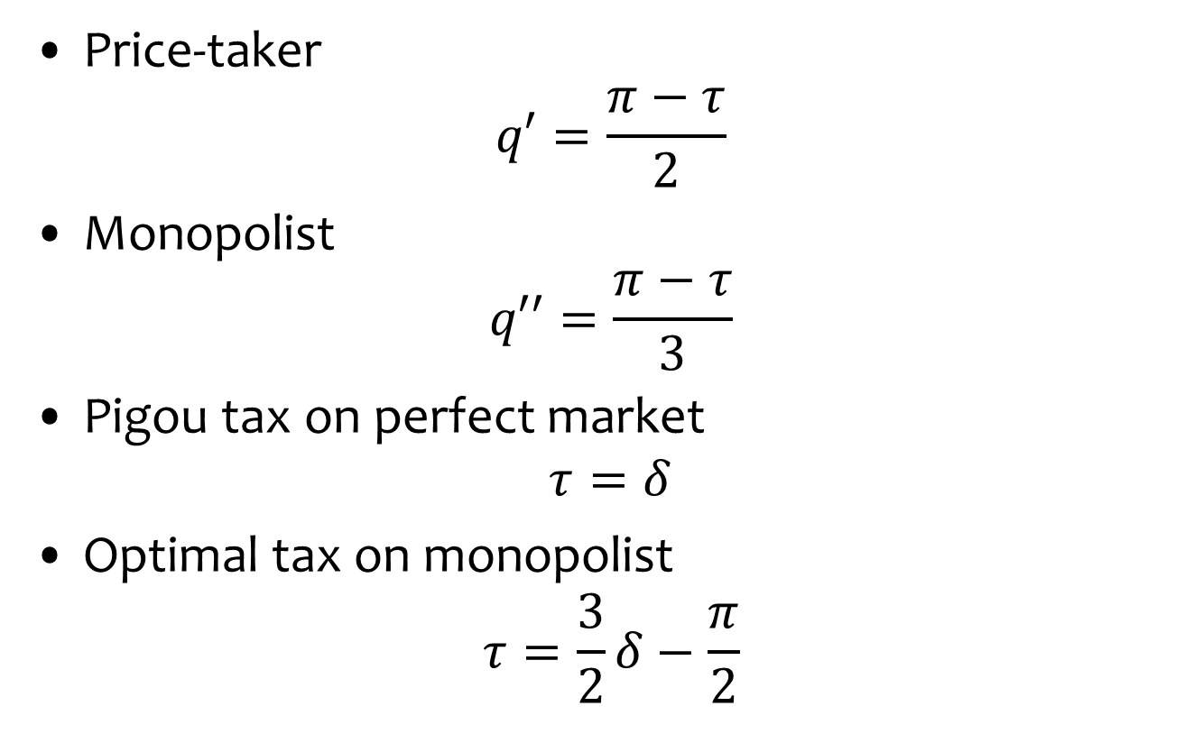
Comparison
Price-taker
$$q′=\frac{π−τ}{2}$$
Monopolist
$$q′′=\frac{π−τ}{3}$$
Pigou tax on perfect market
$$τ=δ$$
Optimal tax on monopolist
$$τ=\frac{3}{2}δ−\frac{π}{2}$$
Tax more than Pigou
as less price response
Tax less than Pigou
to correct market power

Slide 11
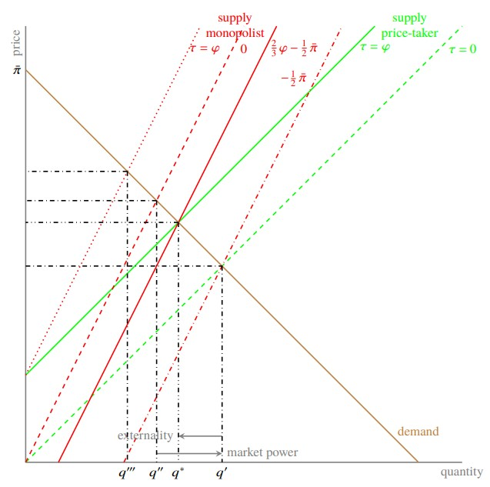

Slide 12
Interpretation
In a perfect market, the pollution tax is the Pigou tax is the marginal damage done by pollution
In a monopoly, if you apply the Pigou tax, output would be too low, because the monopolist suppresses demand
So, you apply a lower tax, one that also reflects the parameters of the demand function
The environmental tax serves two purposes, correcting both externality and market power
The environmental tax reflects that monopolists respond differently to prices than price-takers

Slide 13
Extensions
Analytics are straightforward for monopoly
Monopolies are rare
Other forms of market power are not
Same principles apply to oligopolies etc.
Mathematics harder, no additional fundamental insight: Optimal environmental regulation is different in perfect and imperfect markets
Lots of academic papers
No applications (as far as I know)

Slide 14
Policy Instruments -3
Market power
Adverse selection
Enforcement

Slide 15
Unknown abatement costs
Consider local pollution
Suppose that there are two types of polluters, with high and low costs of emission reduction
Suppose that the regulator does not know which polluter is which
The polluters know, though
The optimal regulation would be to set a polluter-specific tax or standard
But the regulator’s lack of knowledge prevents that (as might non-discrimination rules)

Slide 16
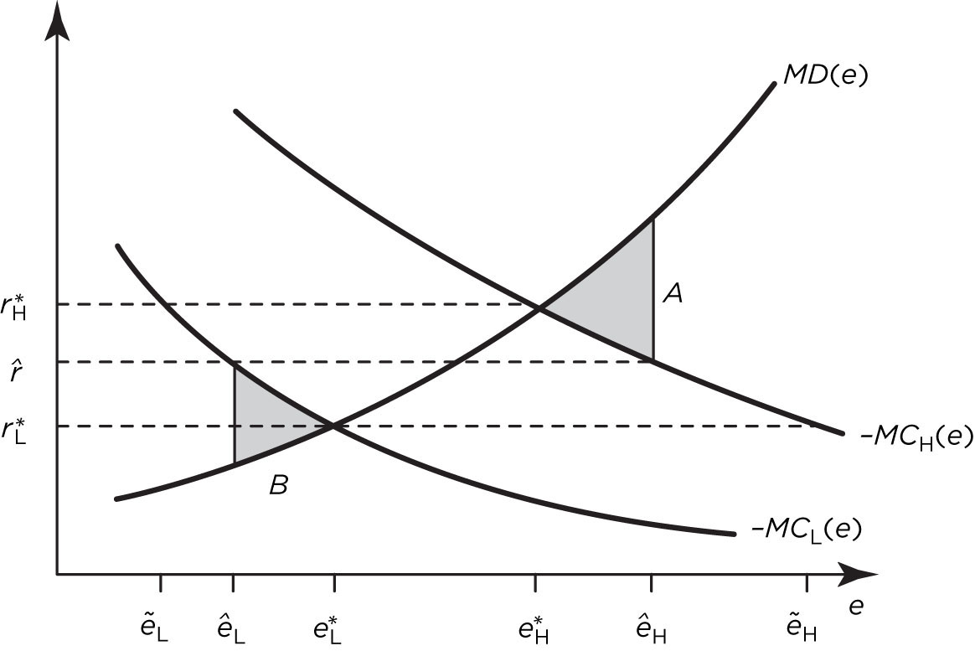

Slide 17
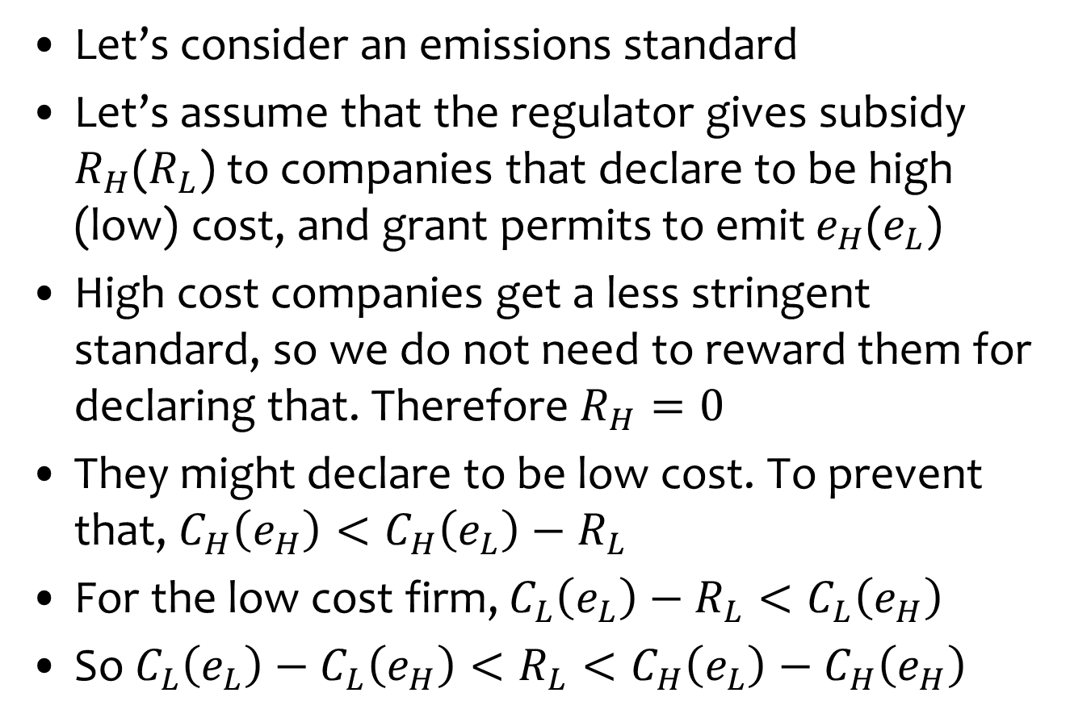
Truth telling
Let’s consider an emissions standard
Let’s assume that the regulator gives subsidy $R_{H}$($R_{L}$) to companies that declare to be high (low) cost, and grant permits to emit $e_{H}$($e_{L}$)
High cost companies get a less stringent standard, so we do not need to reward them for declaring that. Therefore $R_{H}=0$
They might declare to be low cost. To prevent that, $C_{H}\left(e_{H}\right)<C_{H}\left(e_{L}\right)−R_{L}$
For the low cost firm, $C_{L}\left(e_{L}\right)−R_{L}<C_{L}\left(e_{H}\right)$
So $C_{L}\left(e_{L}\right)−C_{L}\left(e_{H}\right)<R_{L}<C_{H}\left(e_{L}\right)−C_{H}\left(e_{H}\right)$

Slide 18
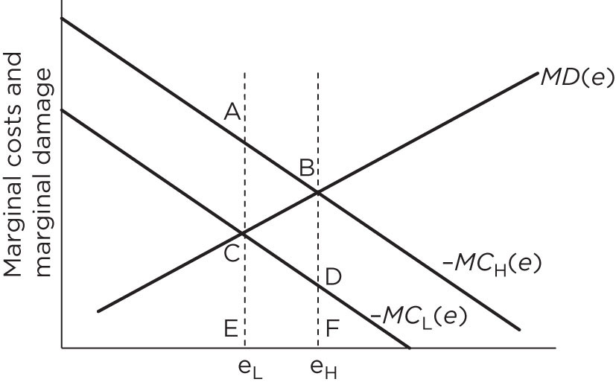
CDFE: Gain from pretending to be high cost if you’re low cost
ABFE: Loss from pretending to be low cost if you’re high cost
Both types of firms reveal their true type if ABFE < R < CDFE

Slide 19
Application
This works in theory but seems unrealistic
Target differentiation based on an objective criterion is legal, also when self-declared
Conditional grants are commonplace too, as are conditional capital subsidies
The regulator needs to combine the two in the right way to induce truth-telling
Key finding: Regulator should focus subsidies on polluters with low-cost emission reduction

Slide 20
Subsidy
Ln(cost of emission reduction)

Slide 21
Application
Adour-Garonne Water Agency
Contracts with 185 polluters
Contract reveals investment in abatement, but not the costs of abatement
Contract specifies subsidies given, either direct or as concessional loans
Info on BOD generated and discharged
Tax on discharge
Regulator got the sign right and, roughly, the size too

Slide 22
Policy Instruments -3
Market power
Adverse selection
Enforcement

Slide 23
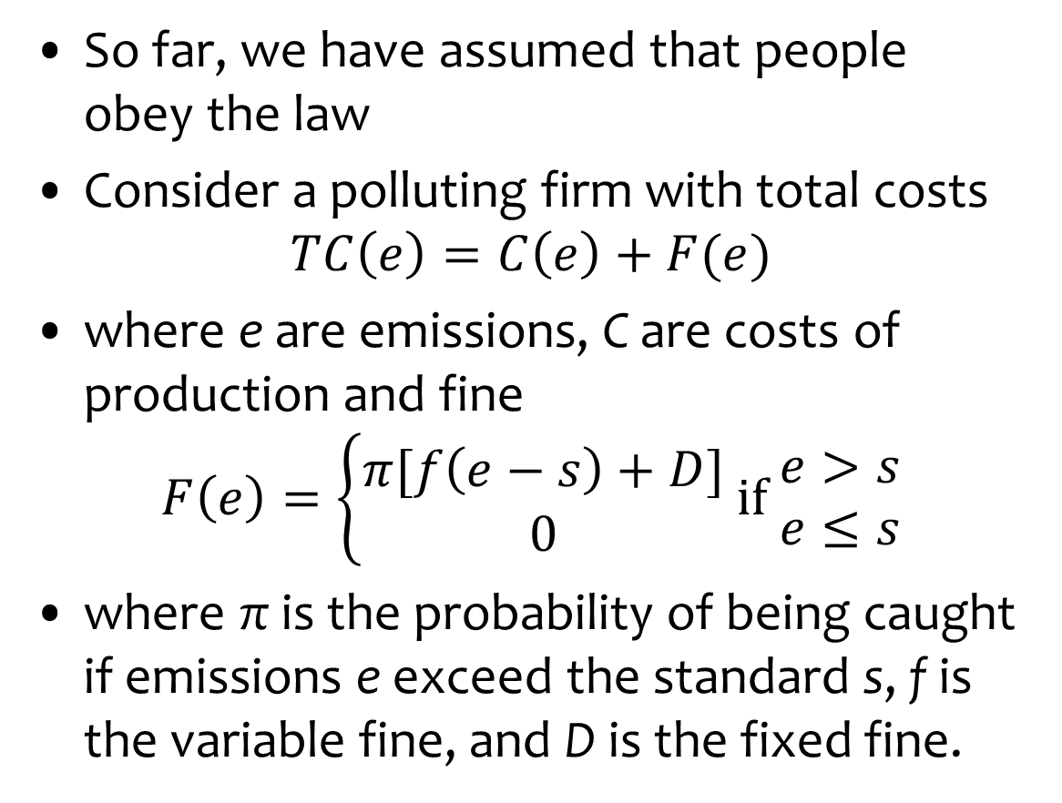
Enforcement
So far, we have assumed that people obey the law
Consider a polluting firm with total costs
$$TC\left(e\right)=C\left(e\right)+F(e)$$
where e are emissions, C are costs of production and fine
$$F\left(e\right)=\left\{\begin{matrix}π[f\left(e−s\right)+D] \\ 0\end{matrix} \text{if} \begin{matrix}e>s \\ e≤s\end{matrix}\right.$$
where π is the probability of being caught if emissions e exceed the standard s, f is the variable fine, and D is the fixed fine.

Slide 24
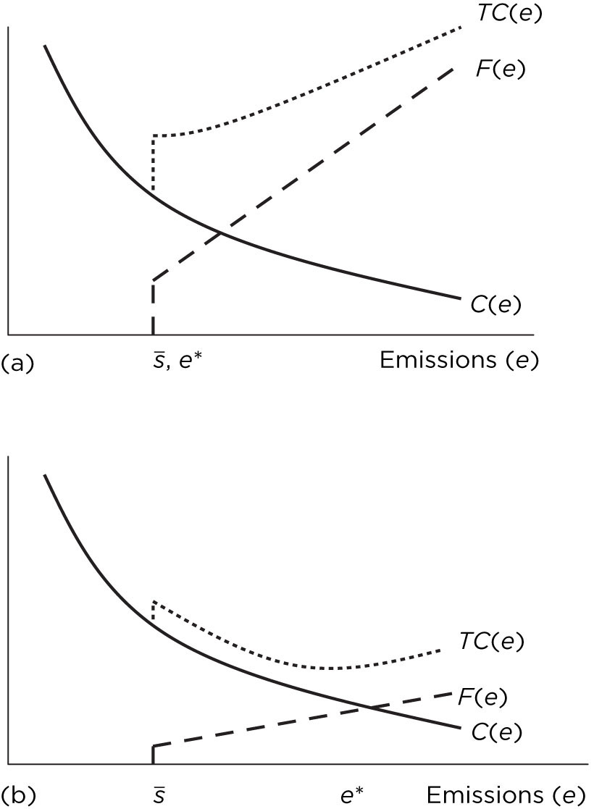
Fine is so high
that company complies.
Fine is not high enough
for compliance.

Slide 25
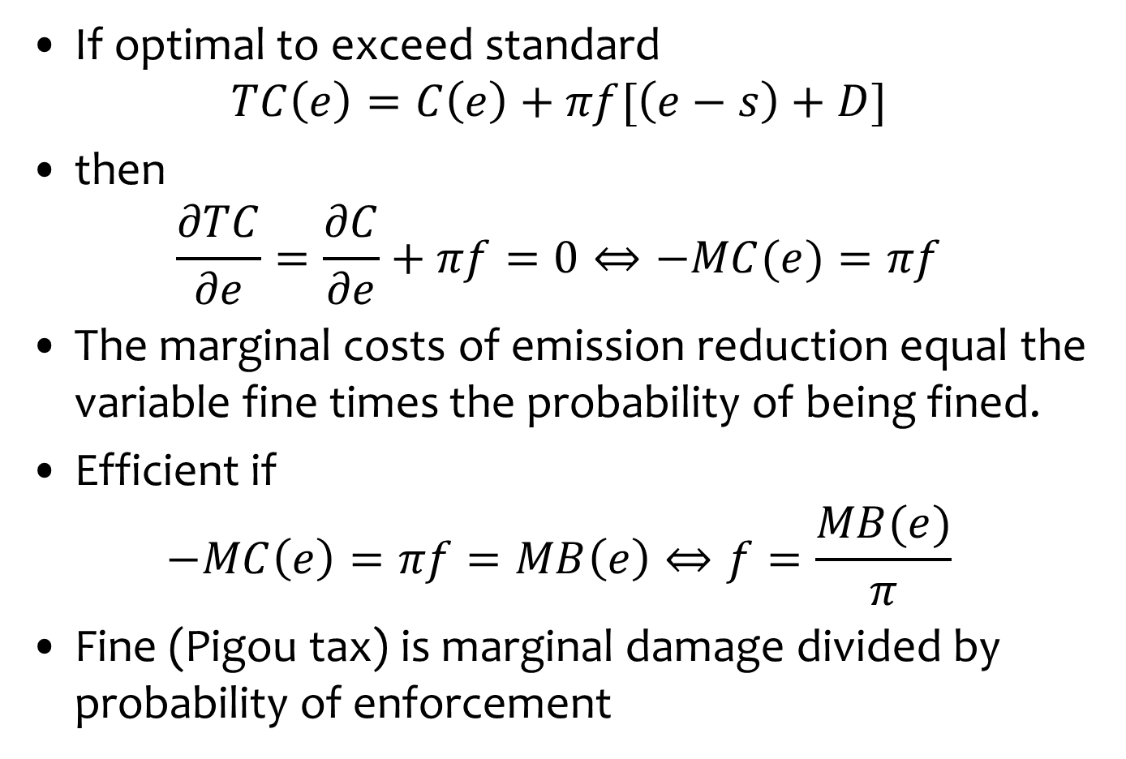
Enforcement
If optimal to exceed standard
$$TC\left(e\right)=C\left(e\right)+πf[\left(e−s\right)+D]$$
then
$$\frac{∂TC}{∂e}=\frac{∂C}{∂e}+πf=0⇔−MC(e)=πf$$
The marginal costs of emission reduction equal the variable fine times the probability of being fined.
Efficient if
$$−MC\left(e\right)=πf=MB\left(e\right)⇔f=\frac{MB(e)}{π}$$
Fine (Pigou tax) is marginal damage divided by probability of enforcement

Slide 26
Quebec, pulp & paper
1985-1990, monthly data,
46 plants
Estimates corrected for
endogeneity and missing
observations
Emissions fall in the year
after the inspection

Slide 27
Duration of spill
USA, pulp & paper, 175 plants, 1979-89
Monitoring
Enforcement

Slide 28
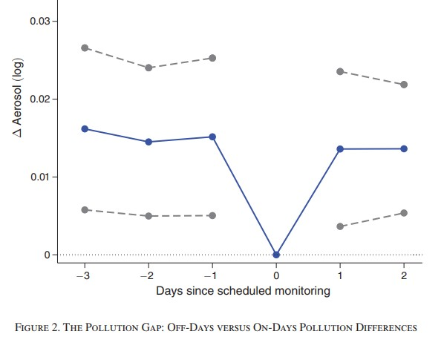
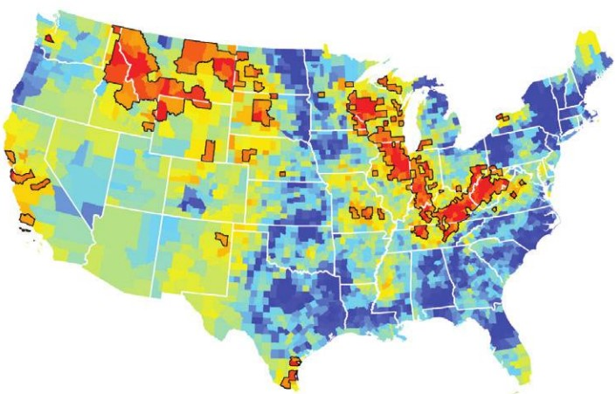
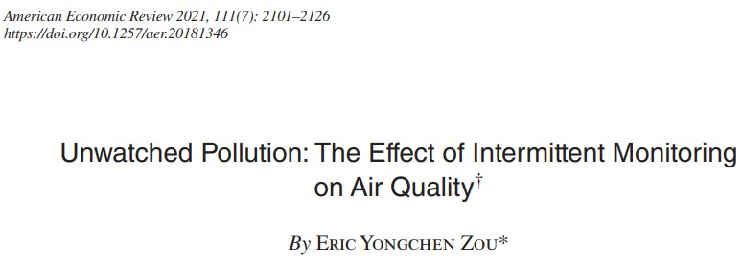
The EPA monitors air pollution every 6th day.
Eric Zou compared EPA monitoring data to satellite data.

Slide 29
The Bakken
Fracking for shale oil also produces shale gas
This is often flared, because gas needs different transport infrastructure
Frackers self-report volume flared
Oil and gas sold are independently monitored
North Dakota, but not other states in the Bakken, limited the fraction of gas that can be flared
Regulators only know the usual ratio of gas to oil, which varies widely
Heat signature of flaring can be seen from space

Slide 30
Ruiwen Lee

